Slide 1

The Art of Storytelling
Art Thomya
Rani Jeyaraj
Mark Wiens
Emilie Couton (facilitator)
Notes:
Let’s start with a couple of stats from Google:
Thailand is a massive content consumer on YT. They watch an average of 4 hours of videos a day on YT
But not only are they consuming content but they are also producing a lot.
On YouTube when you have more than 1M followers you become a Gold channel. There are 30 Gold channels in Thailand.
To be compared with only 15 in Indonesia (with much bigger population)
So that shows the importance of content creation. In this session, we are going through the creation process and the type of stories that actually resonate with travelers, with some key experts.

Slide 2


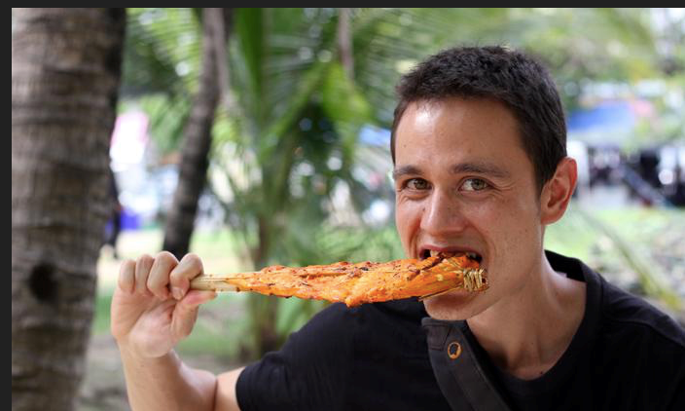
Panellists
Art Thomya
Founder & CEO of Hey! Asean
Mark Wiens
Food blogger and founder of Migrationology
Rani Jeyaraj
Creative Producer, InsiderTV
Notes:
Rani: Creative Producer @ InsiderTV
Never happier than with a script in one hand and a plane ticket in the other, Rani’s passion for storytelling goes hand in hand with her unbridled joy for travel. She moved from TVC to online content.
As Senior Creative Producer at Insider TV, she has developed Editorial Content and Travel Shows for clients ranging from hospitality groups to tourism boards and everything in between.
We work together as the Welcome show
K. Art:
YouTube Host / Ex-Google / CEO & Founder of Hey! Asean
Singer song writer pian player
he had an opportunity to explore innovations from Google and YouTube
offices around the globe. Furthermore, Art is a leading singer of SING OUT ASIA band, a group of Asian
artists who tour around Asia to promote international understanding through music. Art has written songs from his travel experiences.
Art has been dedicated in creating YouTube program in English language to encourage people from around the world to travel to ASEAN (Southeast Asia) and experience local way of living. Collaboration with local friends to show the best thing of their home town
Art is both an international traveller and musician who writes and performs his own songs.
Mark:
Mark Wiens is a full-time travel eater and video blogger who is passionate about sharing local authentic food experiences. He came to travel to Thailand and never left. Tell us the story about your wife
Originally born in the United States, Mark grew up in France, DR Congo, and Kenya, before returning to the USA for university. After graduating in 2008, he bought a one-way ticket to Bangkok to discover the food. He's been eating his way around the world, while blogging and making videos, ever since.
He blogs about his cultural travel adventures on Migrationology and continually dreams about the next meal.
1.2M subscribers on YT channel

Slide 3
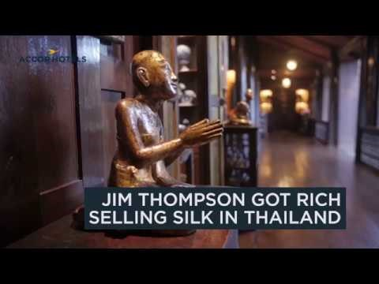
Jim Thompson

Slide 4
Panellists
Art Thomya
Founder & CEO of Hey! Asean
Mark Wiens
Food blogger and founder of Migrationology
Rani Jeyaraj
Creative Producer, InsiderTV
Notes:
Rani: Creative Producer @ InsiderTV
Never happier than with a script in one hand and a plane ticket in the other, Rani’s passion for storytelling goes hand in hand with her unbridled joy for travel. She moved from TVC to online content.
As Senior Creative Producer at Insider TV, she has developed Editorial Content and Travel Shows for clients ranging from hospitality groups to tourism boards and everything in between.
We work together as the Welcome show
K. Art:
YouTube Host / Ex-Google / CEO & Founder of Hey! Asean
Singer song writer pian player
he had an opportunity to explore innovations from Google and YouTube
offices around the globe. Furthermore, Art is a leading singer of SING OUT ASIA band, a group of Asian
artists who tour around Asia to promote international understanding through music. Art has written songs from his travel experiences.
Art has been dedicated in creating YouTube program in English language to encourage people from around the world to travel to ASEAN (Southeast Asia) and experience local way of living. Collaboration with local friends to show the best thing of their home town
Art is both an international traveller and musician who writes and performs his own songs.
Mark:
Mark Wiens is a full-time travel eater and video blogger who is passionate about sharing local authentic food experiences. He came to travel to Thailand and never left. Tell us the story about your wife
Originally born in the United States, Mark grew up in France, DR Congo, and Kenya, before returning to the USA for university. After graduating in 2008, he bought a one-way ticket to Bangkok to discover the food. He's been eating his way around the world, while blogging and making videos, ever since.
He blogs about his cultural travel adventures on Migrationology and continually dreams about the next meal.
1.2M subscribers on YT channel

Slide 5
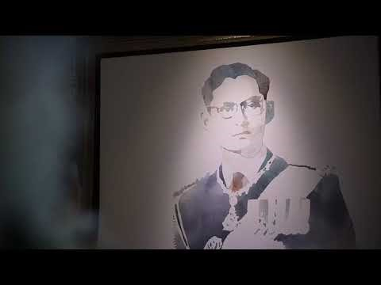
Marndadee
Notes:
How many places on earth that make you feel 'Love' by just passing by?
Rice fields. Trees. Flowers. Gates. Vases. Pictures on the wall. Everything is in good care.
After talking to the owners who are couples, I felt that the 'Love' from their mothers gave them power to pay the love forward by creating this heartwarming place.
Besides, I felt their love for 'King Bhumibol'. The main hall, dining rooms, bed rooms, everywhere is decorated with His Majesty's pictures and sculptures. These reminded me of everything the King has done for Thai people for over 70 years with 'Love'.
Now, has 'Love' inspired you to do something yet?

Slide 6
Panellists
Art Thomya
Founder & CEO of Hey! Asean
Mark Wiens
Food blogger and founder of Migrationology
Rani Jeyaraj
Creative Producer, InsiderTV
Notes:
Rani: Creative Producer @ InsiderTV
Never happier than with a script in one hand and a plane ticket in the other, Rani’s passion for storytelling goes hand in hand with her unbridled joy for travel. She moved from TVC to online content.
As Senior Creative Producer at Insider TV, she has developed Editorial Content and Travel Shows for clients ranging from hospitality groups to tourism boards and everything in between.
We work together as the Welcome show
K. Art:
YouTube Host / Ex-Google / CEO & Founder of Hey! Asean
Singer song writer pian player
he had an opportunity to explore innovations from Google and YouTube
offices around the globe. Furthermore, Art is a leading singer of SING OUT ASIA band, a group of Asian
artists who tour around Asia to promote international understanding through music. Art has written songs from his travel experiences.
Art has been dedicated in creating YouTube program in English language to encourage people from around the world to travel to ASEAN (Southeast Asia) and experience local way of living. Collaboration with local friends to show the best thing of their home town
Art is both an international traveller and musician who writes and performs his own songs.
Mark:
Mark Wiens is a full-time travel eater and video blogger who is passionate about sharing local authentic food experiences. He came to travel to Thailand and never left. Tell us the story about your wife
Originally born in the United States, Mark grew up in France, DR Congo, and Kenya, before returning to the USA for university. After graduating in 2008, he bought a one-way ticket to Bangkok to discover the food. He's been eating his way around the world, while blogging and making videos, ever since.
He blogs about his cultural travel adventures on Migrationology and continually dreams about the next meal.
1.2M subscribers on YT channel

Slide 7
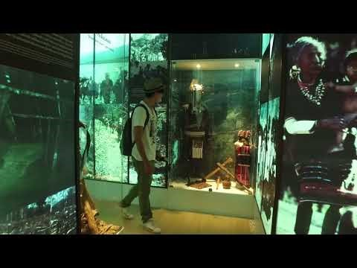
Hall of Inspiration

Slide 8
Panellists
Art Thomya
Founder & CEO of Hey! Asean
Mark Wiens
Food blogger and founder of Migrationology
Rani Jeyaraj
Creative Producer, InsiderTV
Notes:
Rani: Creative Producer @ InsiderTV
Never happier than with a script in one hand and a plane ticket in the other, Rani’s passion for storytelling goes hand in hand with her unbridled joy for travel. She moved from TVC to online content.
As Senior Creative Producer at Insider TV, she has developed Editorial Content and Travel Shows for clients ranging from hospitality groups to tourism boards and everything in between.
We work together as the Welcome show
K. Art:
YouTube Host / Ex-Google / CEO & Founder of Hey! Asean
Singer song writer pian player
he had an opportunity to explore innovations from Google and YouTube
offices around the globe. Furthermore, Art is a leading singer of SING OUT ASIA band, a group of Asian
artists who tour around Asia to promote international understanding through music. Art has written songs from his travel experiences.
Art has been dedicated in creating YouTube program in English language to encourage people from around the world to travel to ASEAN (Southeast Asia) and experience local way of living. Collaboration with local friends to show the best thing of their home town
Art is both an international traveller and musician who writes and performs his own songs.
Mark:
Mark Wiens is a full-time travel eater and video blogger who is passionate about sharing local authentic food experiences. He came to travel to Thailand and never left. Tell us the story about your wife
Originally born in the United States, Mark grew up in France, DR Congo, and Kenya, before returning to the USA for university. After graduating in 2008, he bought a one-way ticket to Bangkok to discover the food. He's been eating his way around the world, while blogging and making videos, ever since.
He blogs about his cultural travel adventures on Migrationology and continually dreams about the next meal.
1.2M subscribers on YT channel

Slide 9
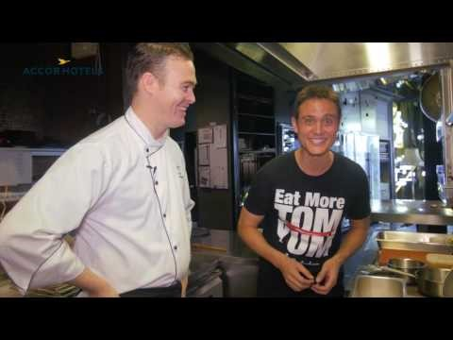
Where Chefs Eat
Notes:
Rani

Slide 10
Panellists
Art Thomya
Founder & CEO of Hey! Asean
Mark Wiens
Food blogger and founder of Migrationology
Rani Jeyaraj
Creative Producer, InsiderTV
Notes:
Rani: Creative Producer @ InsiderTV
Never happier than with a script in one hand and a plane ticket in the other, Rani’s passion for storytelling goes hand in hand with her unbridled joy for travel. She moved from TVC to online content.
As Senior Creative Producer at Insider TV, she has developed Editorial Content and Travel Shows for clients ranging from hospitality groups to tourism boards and everything in between.
We work together as the Welcome show
K. Art:
YouTube Host / Ex-Google / CEO & Founder of Hey! Asean
Singer song writer pian player
he had an opportunity to explore innovations from Google and YouTube
offices around the globe. Furthermore, Art is a leading singer of SING OUT ASIA band, a group of Asian
artists who tour around Asia to promote international understanding through music. Art has written songs from his travel experiences.
Art has been dedicated in creating YouTube program in English language to encourage people from around the world to travel to ASEAN (Southeast Asia) and experience local way of living. Collaboration with local friends to show the best thing of their home town
Art is both an international traveller and musician who writes and performs his own songs.
Mark:
Mark Wiens is a full-time travel eater and video blogger who is passionate about sharing local authentic food experiences. He came to travel to Thailand and never left. Tell us the story about your wife
Originally born in the United States, Mark grew up in France, DR Congo, and Kenya, before returning to the USA for university. After graduating in 2008, he bought a one-way ticket to Bangkok to discover the food. He's been eating his way around the world, while blogging and making videos, ever since.
He blogs about his cultural travel adventures on Migrationology and continually dreams about the next meal.
1.2M subscribers on YT channel

Slide 11
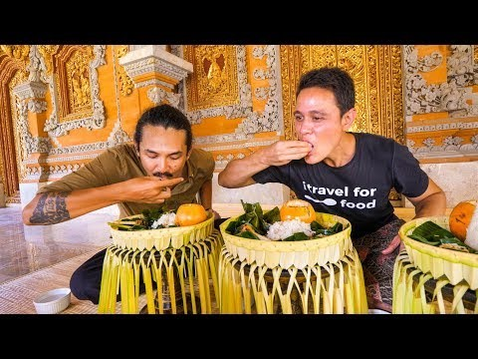
Royal Balinese Food

